Slide 1
Columbia Asia Hospital Data Analysis
Catalyzing Care: Unveiling Insights from Columbia Asia Hospital Data

Slide 2

About Columbia Asia Hospital
Columbia Asia is an international private healthcare company with an extensive network of hospitals across Africa, China, India, Indonesia, Malaysia and more.
Columbia Asia started its operations in 1996, with the first hospital acquired a year later in Sarawak, East Malaysia.

Slide 3
Columbia Asia Hospital Data Analysis project focuses on extracting valuable insights from the hospital's data repository to drive informed decision-making and enhance operational efficiency.
Objective 1
Objective 2
Objective 3
Optimize Patient Care
Analyze patient demographics, wait times, satisfaction scores, and departmental visit patterns to improve patient experience and healthcare delivery.
Financial Health Assessment
Evaluate hospital profitability, revenue streams, expense management, and cost-saving opportunities to ensure sustainable financial performance.
Strategic Decision Support
Provide actionable insights and recommendations for strategic decision-making, such as hiring new doctors, implementing cost-saving measures, and enhancing revenue-generating services.

Slide 4
Dataset Summary
Total Revenue Generated
509 M
Average Waiting Time
No. Of Patients Visited
35.26 minutes
9216
Highest Appointment Fees Department
Most Visited Department
Average Patient Satisfaction Score
Number of Male Visits
Number of Female Visits
General Practice (7,240 visits)
4.98
(on scale of 10)
Neurology ($1,500)
4,705
4,487

Slide 5
Data Cleaning and Preprocessing
This data is critical for analysis because it provides insights into various aspects of hospital operations, patient demographics, financial performance, and healthcare outcomes.
By cleaning and preprocessing the data effectively, we ensure that the analysis is based on reliable and accurate information, leading to more meaningful conclusions and actionable insights for decision-making within the hospital setting.
Handling Missing Values: Checking for and addressing any missing values in the dataset, either by imputing them with appropriate values or removing them if they significantly impact the analysis.
Data Type Conversion: Ensuring that the data types of columns are appropriate for analysis, such as converting date columns to date format, numeric columns to numerical format, and categorical columns to categorical format.

Slide 6
Analytical Approach and Tools
Data Cleaning
Data Enrichment
Types of Analysis Conducted
Data Type Conversion: Used Power Query Editor in Power BI to convert date columns to date format and ensure appropriate data types for numerical and categorical columns.
Handling Missing Values: Employed Power Query Editor to address missing values by imputing them or removing them as necessary.
Created new features or variables using DAX functions such as CALCULATE, FILTER, and RELATED to enhance the analysis, such as deriving age groups from birth dates or calculating ratios between different numerical variables.
Descriptive Analysis: Used Power BI visualizations (e.g., bar charts, line charts) to perform descriptive analysis of patient demographics, departmental visits, revenue trends, and patient satisfaction scores.
Segmentation Analysis: Conducted segmentation analysis by age groups, gender, race, and department referrals to understand patterns and trends in patient visits and healthcare needs.

Slide 7
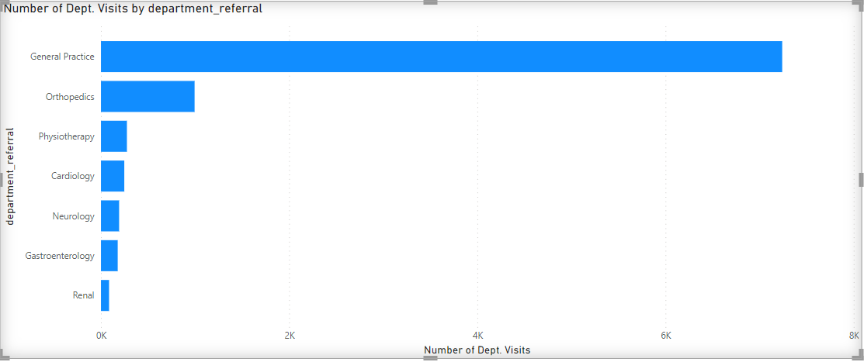
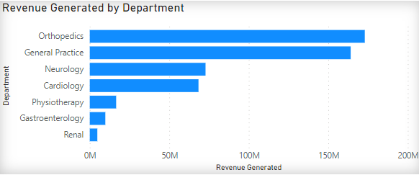
Department Segmentation
General Practice (7240 visits) And Orthopedics (995 visits) are mostly frequently visited Department.
Most Revenue Generating Department is Orthopedics with
$172.93 M.
Neurology is charging highest appointment fees: $1500

Slide 8
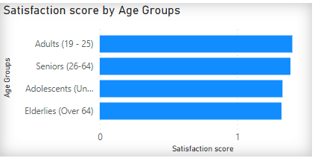
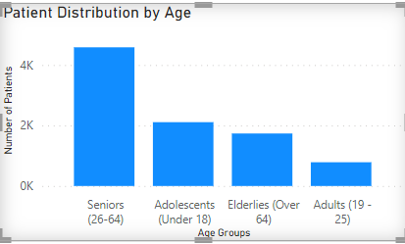
Age Segmentation
The Largest User Group is aged 26-64 comprising 49.75% of the patients.
Elderlies (over 64) age group has lowest satisfaction score.
Average Patient Wait-time is 35.26 minutes.

Slide 9
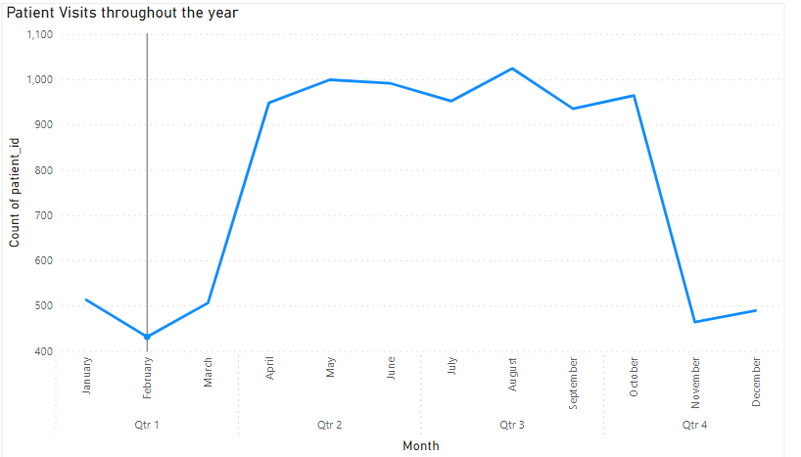
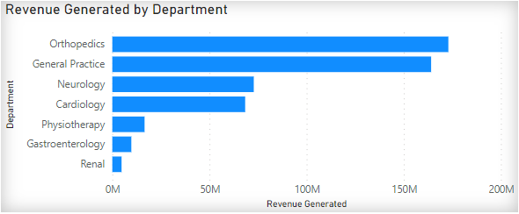
Throughout the year analysis
Out of all the months, november has seen the biggest dip in patient visit volume.
Most Revenue Generating Department is Orthopedics with
$172.93 throughout the year.
Neurology iHas highest waiting time of 36.8 mins.

Slide 10
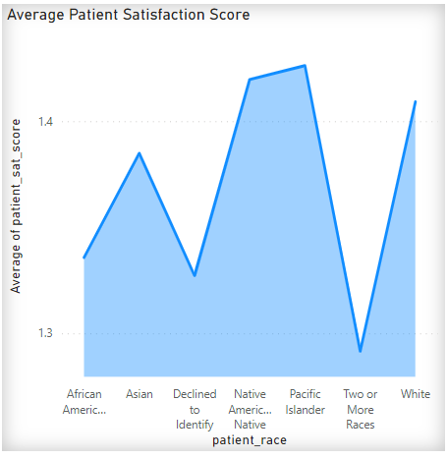
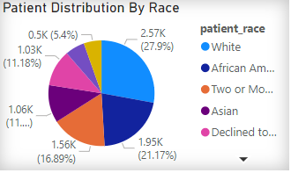
Demographics Analysis
The Group Comprising of Two or more race has lowest Patient Satisfaction Score
Patients Having race White are in majority constituting 27.9%.
Patients having race “Native American/Alaska Native” face largest average waiting time of 35.69 minutes.

Slide 11
Strategic Recommendations
Discount on Patient Demographics
Improve Patient Wait-times
Adjust for Seasonal Trends
Elderlies (Over 64): Lower satisfaction scores indicate potential areas for improvement in healthcare services and patient experience. Tailor discount offers to address the specific needs and preferences of elderlies, such as discounted rates for preventive screenings, geriatric consultations, or mobility aids.
African American, Asian, and Two or More Races: These racial groups show significant visit volumes across various departments. Tailor discount offers to cater to the healthcare needs of these racial groups, such as discounted rates for culturally sensitive care, language interpretation services, or preventive health programs.
Consider offering incentives to patients in departments with unusually long wait times, such as Neurology and Physiotherapy, to improve patient satisfaction and experience.
Leverage seasonal trends in patient visits to implement strategic discounts during periods of higher or lower patient activity. For example, offer discounts during peak seasons like Quarter 3 and holiday seasons.

Slide 12
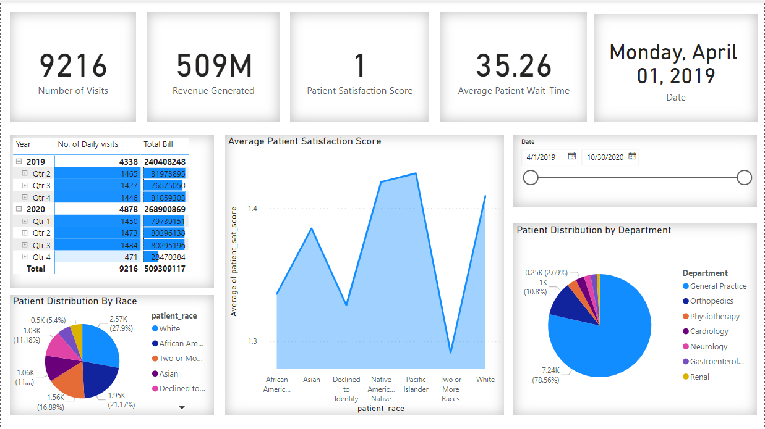
Dashboard Demo
(Main Tab)
This tab focuses on the Performance metrics of a particular day or range of dates.
It segments the data on different attributes like departments, Patient Satisfaction Score, Wait Time, revenue generation and more.
This tab has a date slicer to choose the date for which data has to be segregated.

Slide 13
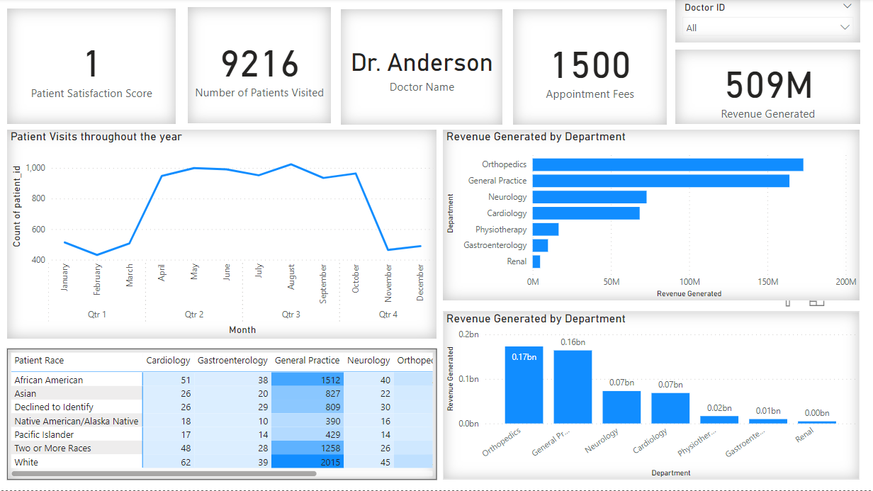
Dashboard Demo
(Doctors Tab)
This tab focuses on the Performance metrics of a particular doctor.
It shows the performance based on different attributes like Number of Patient generated, Patient Satisfaction Score, Wait Time, revenue generation and more.
This tab has a Doctor ID slicer to choose the Doctor ID of the Doctor whose performance is to be reviewed.

Slide 14
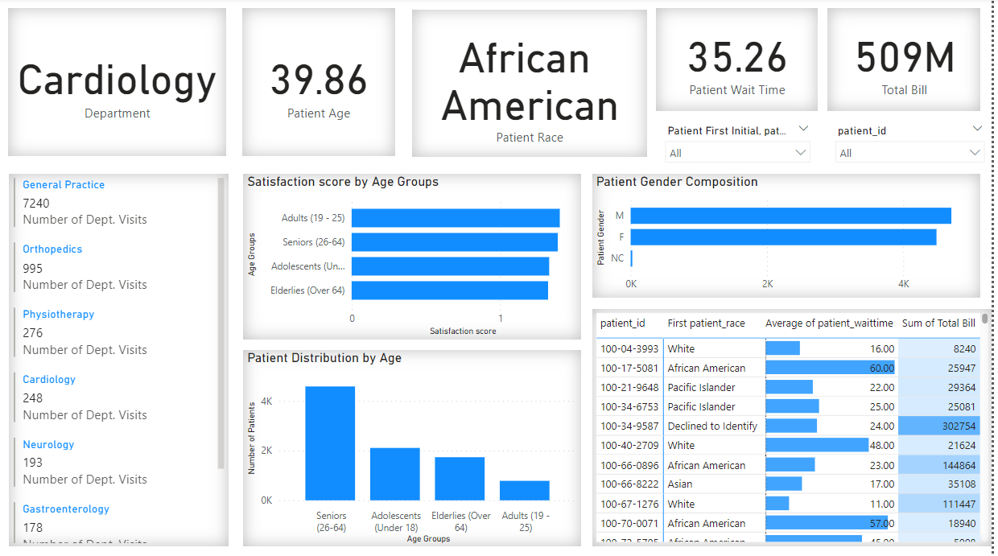
Dashboard Demo
(Patients Tab)
This tab focuses on the Quantitative Analysis of a particular or a group of patients.
It segments the data on different attributes like Age Groups, Demographic Race, Wait Time, Total Bill and more.
This tab has a Patient name & Patient ID slicer to choose the patient for which data has to be segregated.

Slide 15
Summary of Key findings and Suggestions regarding them.
Patient Demographics Analysis
Department Visit Patterns
Patient Wait Time and Satisfaction Analysis
Findings: Certain age groups, such as adults (19 - 25), show higher average satisfaction scores compared to others
Suggestions: The hospital can tailor its services and care protocols to better meet the needs and preferences of different age groups, leading to improved patient satisfaction and experience.
Findings: General Practice and Orthopedics departments receive the highest number of visits, suggesting higher patient demand these departments
Suggestions: The hospital can allocate resources and staff accordingly to manage patient flow efficiently in high-demand departments and consider expanding services or capacity in these areas to meet patient needs.
Findings: There is a negative correlation between patient wait time and satisfaction scores, indicating that longer wait times may lead to lower satisfaction levels
Suggestions: The hospital should focus on reducing wait times through operational improvements, scheduling optimizations, and resource allocation to enhance patient satisfaction and overall quality of care.

Slide 16
Conclusion
In conclusion, our data analysis has unearthed crucial insights that demand immediate action.
For instance, the negative correlation between patient wait times and satisfaction scores underscores the urgent need to streamline our processes to enhance patient experience.
Furthermore, the profitability analysis revealed significant variations among doctor IDs, highlighting the importance of targeted strategies to boost financial performance.
By translating these insights into actionable initiatives, we can drive operational efficiency, improve patient outcomes, and strengthen our position as a leading healthcare provider committed to excellence.
max growth

